Slide 1
Millennials & Gen Z
Team 6 - Summer 2019

Slide 2


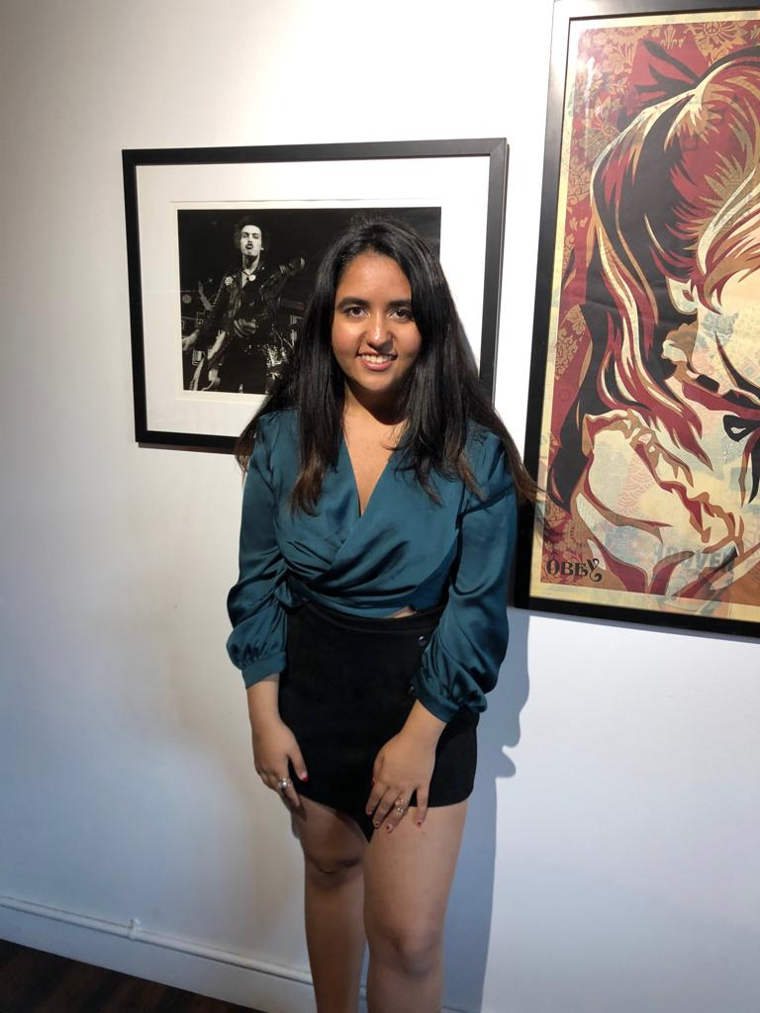
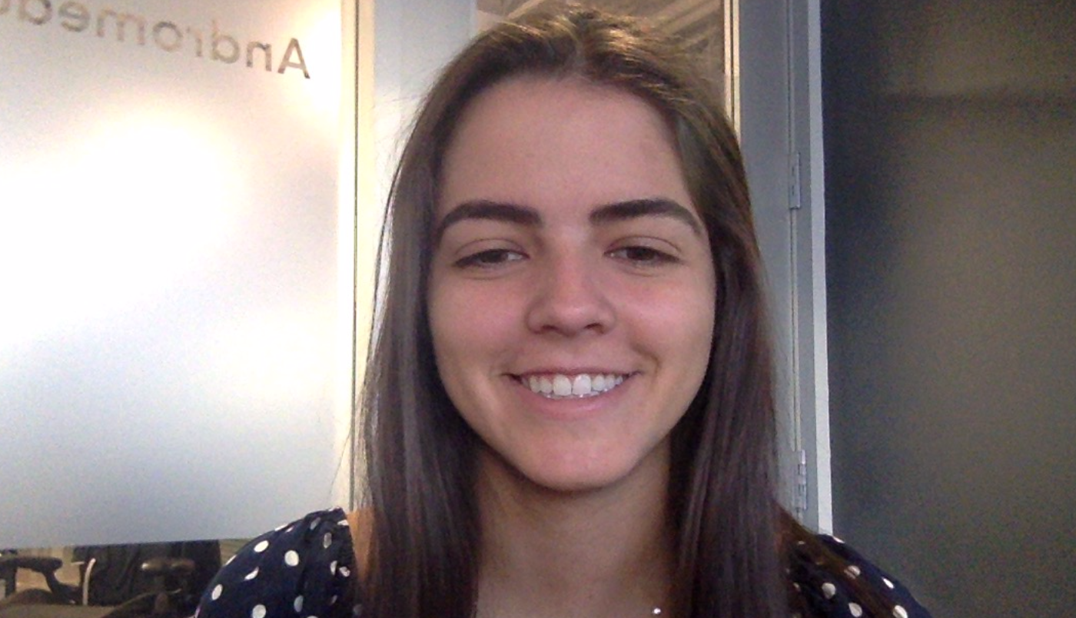
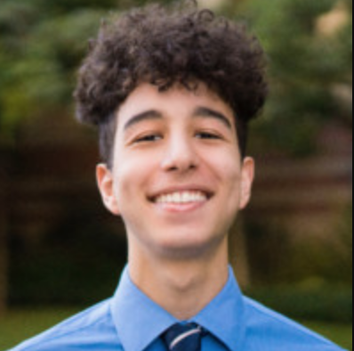
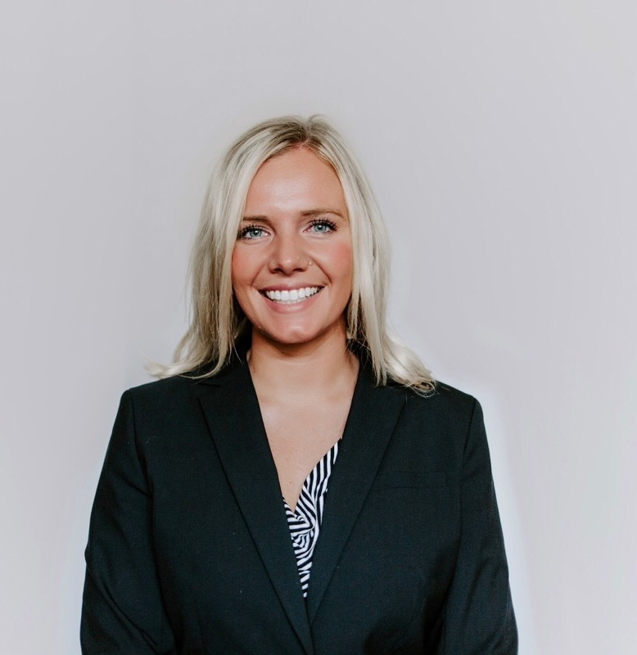
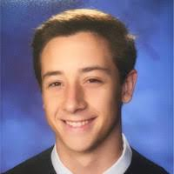

Team Intro
Cynthia Vu
Michael Hagmaier
Hollywood, Product
Hollywood, Pricing
Maansi Manchanda
Victoria Lasarte
Hollywood, Engineering
Hollywood, Salesforce
https://www.linkedin.com/in/robertyee24/
Isaac Iguelmamene
Hollywood, Engineering
Sierra Kempthorn
Holywood, Marketing
Robert Yee
Ryan Nakamura
Sean Carnahan
Hollywood, Engineering
Hollywood, Client Support
HollyWood, Checkout

Slide 3

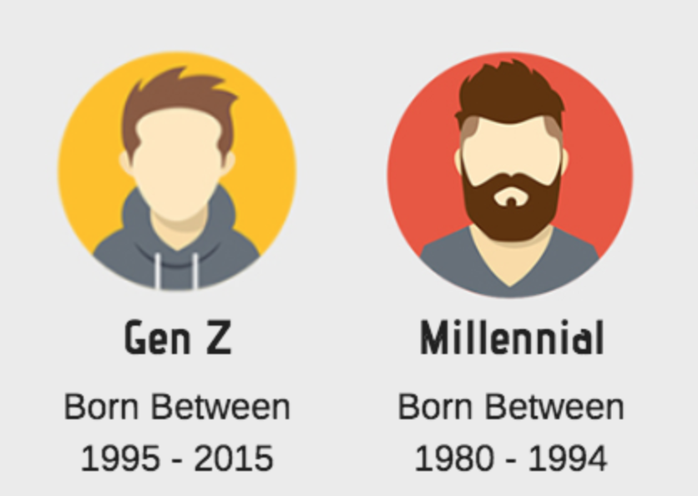
Target Audience
Persona
Target Universities/ Recent Grads
Demographic 18-30 years old
Over 8 in 10 millennials attended a live experience in the past year.
Notes:
Ex: Here is our target audience Kyle, he attends Stanford University. Majors in communications. Is a fifth year senior and attends the occasional frat party.
something to be said about getting young people in early. We are in it for the long haul. less focused on the revenue now more on the future aspect. name to file- make sure the venue knows who is at it. get fans and more heads. developing relationships that will pan out later.
https://www.eventbrite.com/blog/academy/5-tips-to-improve-student-engagement/
Eventbrite survey - Over 8 in 10 millennials (82%) attended or participated in a variety of live experiences in the past year, ranging from parties, concerts, festivals, performing arts and races and themed sports—and more so than other older generations (70%).

Slide 4
Our Focus
What additional products or services should Ticketmaster offer to grow revenue per customer?
Distressed Tickets
Event Bundling
Loyalty Program
Credit Card
Notes:
Retaining customers
50% consumer change their behavior to reach a higher tier
76% consumers view programs as part of their relationship with the brand
Can target at risk customers to try to bring them back into the brand
Ability to Tailor
can find out what benefits are important for their fans
can use it as a means to conduct research amongst their fans and can potentially segment it even further
Better communication
6/10 customers say surprise rewards are a reason to stay loyal. Easier to reach out on profile or something with surprise
Customer Advocacy
unhappy customers are more inclined to act & share their neg experience
81% of customers trust recommendation from friends & families rather than the company

Slide 5
Distressed Tickets

Slide 6
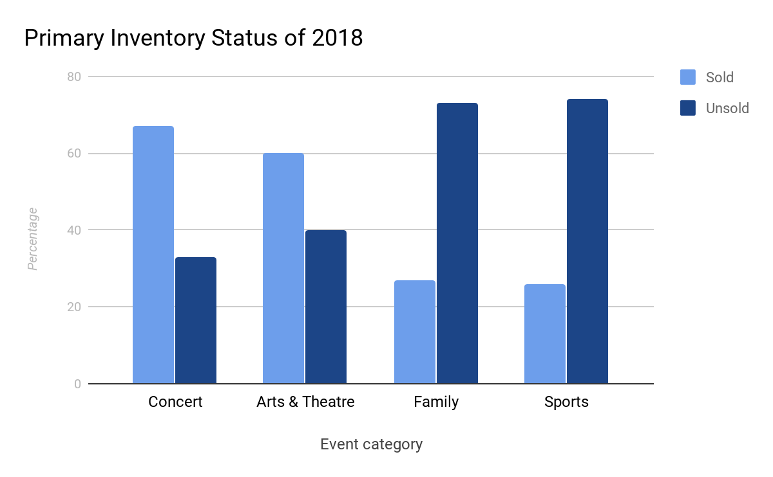
Large Number of Tickets Go Unsold
The Problem
The daily average sell through percentage for 2018 was 47% for all events across Ticketmaster.
For concerts specifically, only 67% of tickets were sold
We define distressed tickets as those we can predict 3 days before that will not get sold
Notes:
What we consider distress is tickets that go unsold. But for our ideas we brought it up a notch and made it tickets that are unsold within 3 days of events...
introduce graph, show numbers for all them
explain why it’s a big problem
zone down to the fact that we’re focusing on concerts (appeals to our target audience)

Slide 7
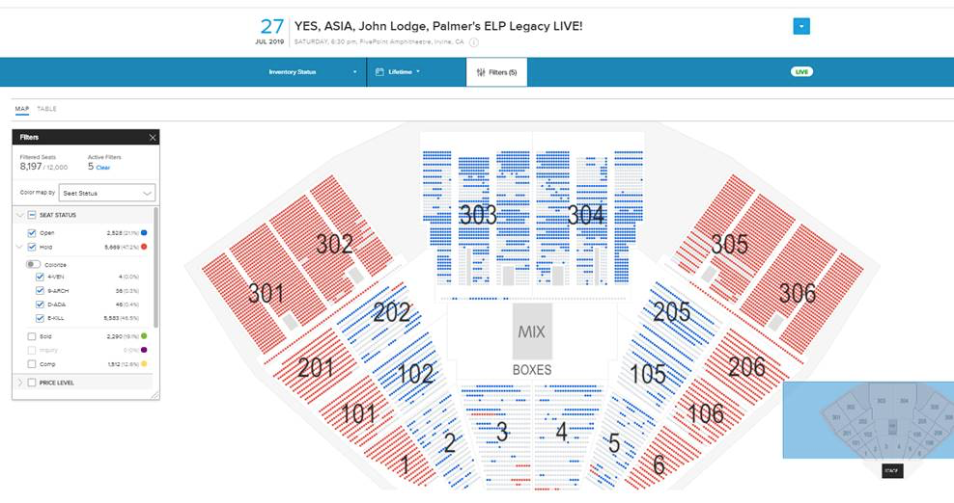
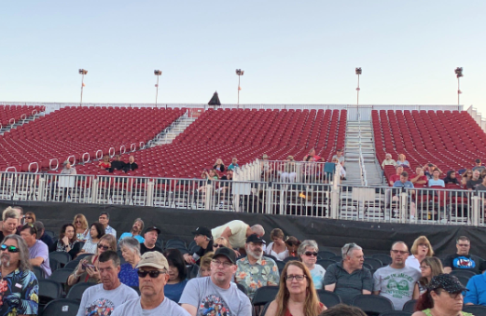
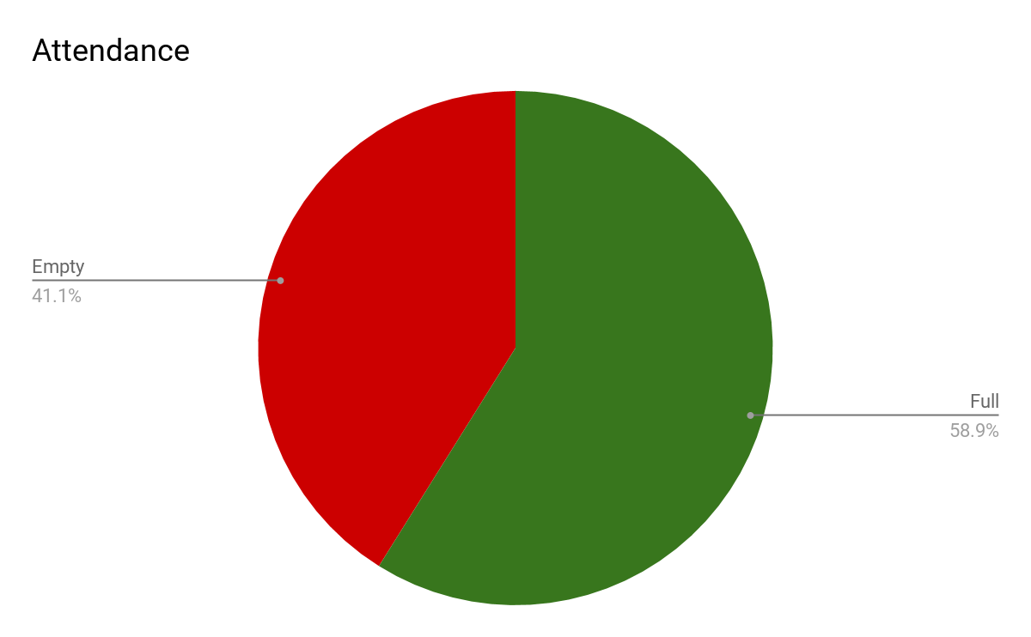
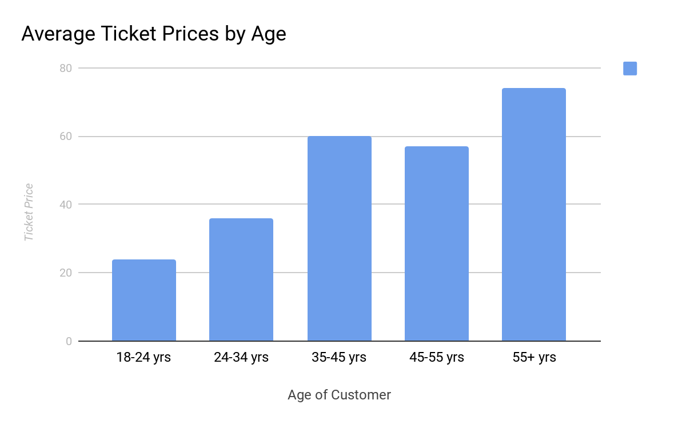
YES concert July 27th at FivePoint Amphitheatre
Blues are unsold seats and the Reds are holds
Case Study
60% of the venue was either on hold or open tickets
Younger attendees bought cheaper priced tickets
We only identified 759 fans who attended the venue
Venue is 20 minutes away from University of California, Irvine
Notes:
change colourrrrr of pie graph
Drive home the fact that we can predict a day or 2 before the tickets that are going to be unsold
Who will buy these tickets? - college

Slide 8
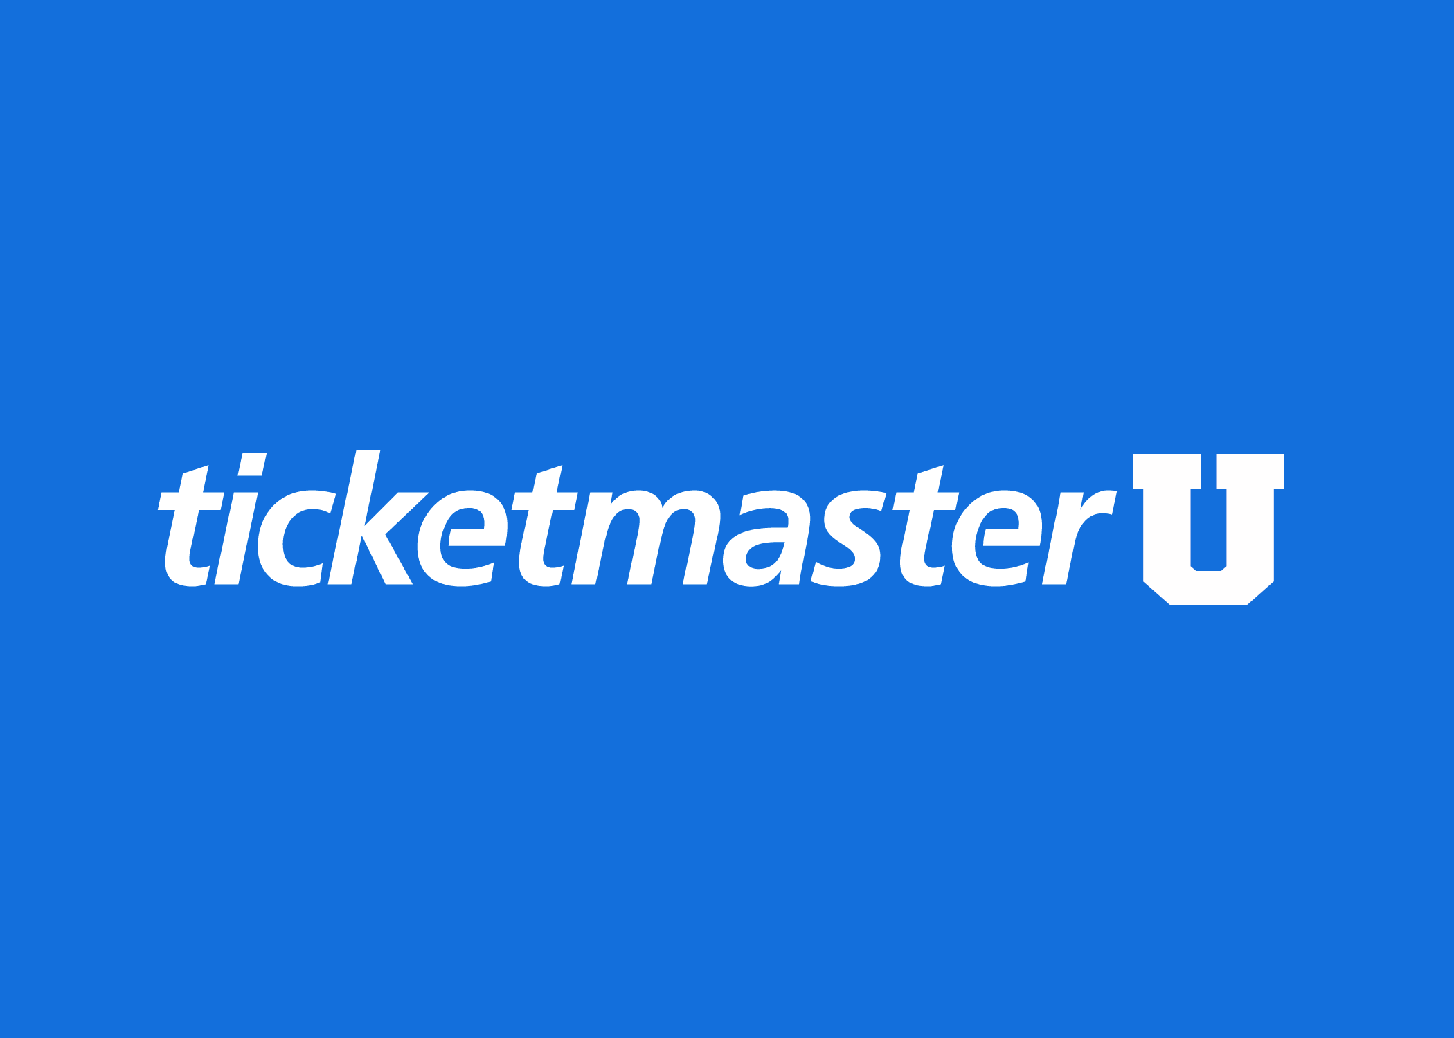
Our Solution
Independent
Young
Affordable
Separate exclusive entity from the main Ticketmaster app
Has an edgier vibe that is appealing to millenials
For the average broke college student
Notes:
prepare what we would want to say about this.
independent - .edu address makes it exclusive, give us a direct channel between us and the upcoming fanbase
young - more fun, exciting image to align with
af
make sure to hit on the .edu exclusive
something to be said about getting young people in early. We are in it for the long haul. less focused on the revenue now more on the future aspect. name to file- make sure the venue knows who is at it. get fans and more heads. developing relationships that will pan out later.
https://www.eventbrite.com/blog/academy/5-tips-to-improve-student-engagement/
Eventbrite survey - Over 8 in 10 millennials (82%) attended or participated in a variety of live experiences in the past year, ranging from parties, concerts, festivals, performing arts and races and themed sports—and more so than other older generations (70%).

Slide 9


Product direction
Two possible routes
Idea #1
Idea #2
Display Low Priced Tickets
Subscription Service
Cheap
Free
Display tickets that are considered distress and are below $30
Give access to flash sale of free tickets for a monthly subscription fee.
Factors to be considered for both different options
Could be a combination of both formats of selling tickets
Notes:
Idea 1: We are just going to display tickets that are under a certain price threshold (once we identify it as distress)
-basically any events, or concerts in specific, that we have identified will be displayed onto our app for users to see and potentially buy
Idea 2: Subscription service: Basically what this is is that we charge monthly for students to join an even exclusive part of this app where they are open to see flash free tickets for various events (details for this will be worked out with the venue).
Also the reason for having these two ideas be somewhat open ended is because we understand that there are a lot of testing behind this..which we currently dont have teh data for…
Example: data science testing/machine learning stuff
talk about this as one of the ideas -> vouchers
students most likely wont pay subscription service

Slide 10
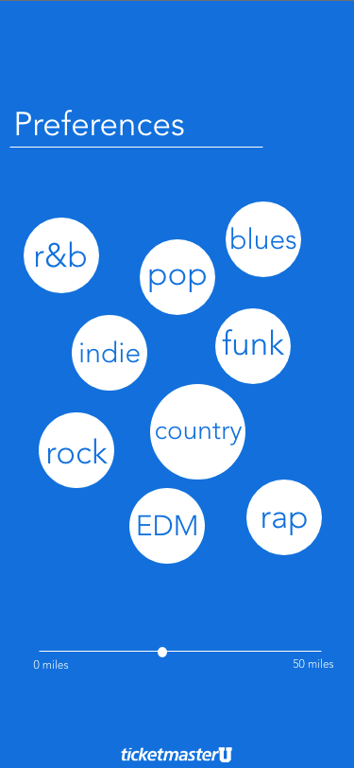
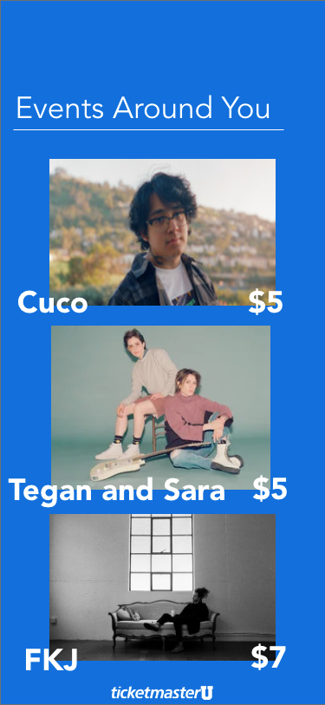
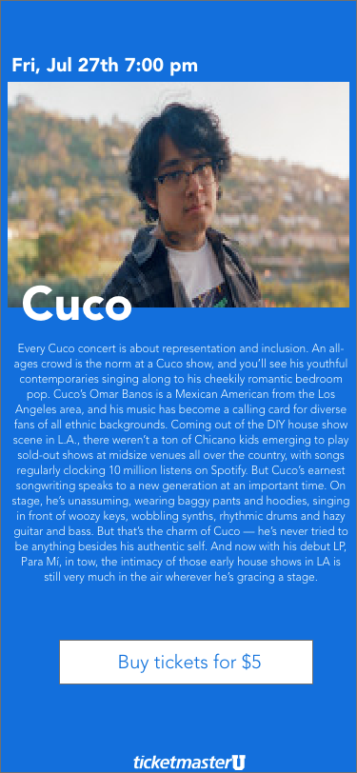
App Mockup
Notes:
You can change up your location to adjust where your school is or other schools etc.
You cna choose your music preference
Shows summary of artist + some songs they have + link to where you can buy + price

Slide 11
Key Features
Student Membership
Curated Events
Low Prices
Geographical filter
Events on the app would be predicted using data and trends every week and displayed based on personal preferences
Either free or under a certain threshold, tickets on the app would be budget friendly
Events are ordered by distance from user and within a bounded area
The app would be accessible only with a .edu email address
Notes:
As mentioned before, we have events that are curated towards the person along with our qualified distress tickets
Low prices since it will be under a threshold and we have that free perk
Geographic filter is able to be adjust based off your school and radius
Student memebership taht you can only use for .edu to maintain exclusivtiy

Slide 12

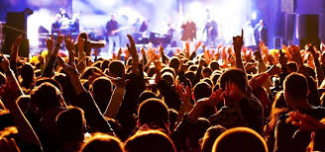
Benefits
Artists
Students
Discovery of New Audiences
Audience Expansion
Fuller Venues
Ticketmaster
Increased Revenue
Secure Ticketing
Loyalty to TM Brand
Artist Loyalty
Cheap Tickets
Exclusivity
Location
Last Minute
Notes:
This will greatly benefit Ticketmaster in 3 different major categories, the Students, the Artists, and of course Ticketmaster
Students
cheap tickets
College Student are always looking for cheap fun activities to do on the weekend so the cheap and affordable tickets will provide a spontaneous adventure for many college students.
exclusivity
Due to the fact that they need a .edu address to sign up with. Students are going to see that this event is tailored towards their college and that by going to this event there will be potential for them to meet new people from their school.
location
The students will only be alerted if the event is happening near their college.
last minute
Since college Students are constantly doing things last minute anyway this would be the perfect demographic for last minute sales.
Artist/ Venues:
1. Discovery of New Audiences
Students who might not know much about the artist would be willing to go just based off the fact that this nearby is so cheap and convenient and might end up liking this artist.
2. Artist Expansion
and with Artist expansion. Artists are always looking for to know who their fans are, especially their college bases. This would allow artists to know exactly who their fans are and their potential fans who maybe are just discovering this new artist.
3. Fuller Venues
And Of Course this will increase the Ticket Sell Thru
ticketmaster
1. Increased Revenue
Of course more ticket sales will lead to more profit
2. Secure Ticketing
The .edu address would add an extra layer of security because it is difficult for brokers to make false accounts with a .edu address and only
3. Loyalty to TM Brand
Drive fan loyalty and build fan relations into a new demographic
4. Artist Loyalty
Ticketmaster’s ability to provide a route to reach younger audience will definitely peak Artist’s interest in trying to reach this audience.

Slide 13


The Road Map to Rap

Slide 14

What Are We Proposing?
MEGARAP
One package price for multiple shows
Hip-Hop/R&B is Ideal for Packaging
Why and How?
Notes:
add hip hop artists
slides:
intro to rap package “what”
streaming and sales indication “why”
case study
marketing/why is it good/ push notification
simplicity
mobile enabled

Slide 15
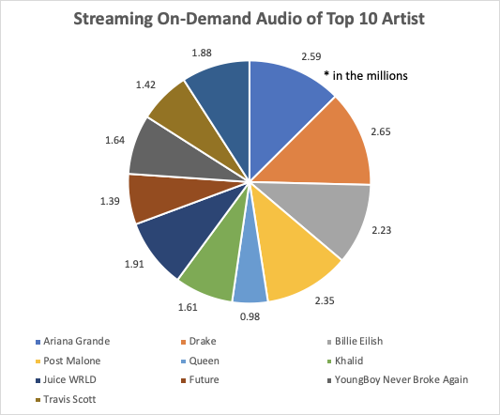
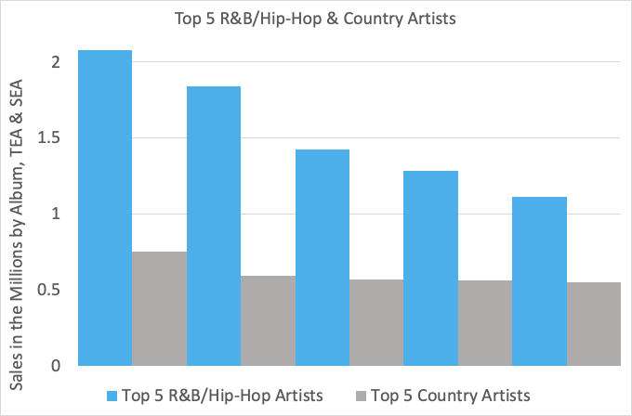
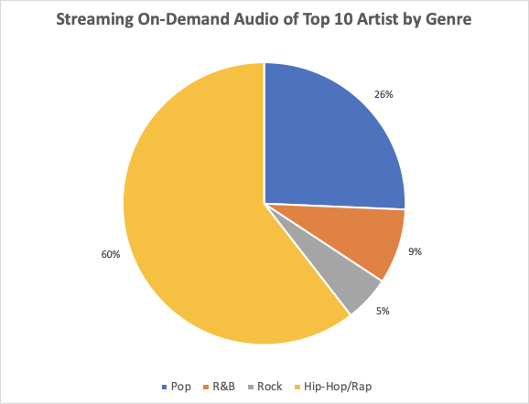
Why Rap?
MEGARAP
Drake
Post Malone
Khalid
Juice WRLD
Future
Luke Combs
FGL
Thomas Rhett
Jason Aldean
Chris Stapleton
Notes:
Why Rap? Let me explain...
As you can see there are three graphs we’ll be focusing on here. For starters we’ll focus with the big bar graph. Here we have a comparison between the Top 5 artists of Country and Hip-Hop of 2019. So these are the Top 5 artists of their respective genres. These sales numbers represent the number of albums, TEA (Track Equivalent Album) and SEA (Stream Equivalent Album) per artist for the year of 2019.
Moving onto the two pie charts on the left, we have the Top 10 artists in the WHOLE music industry (as of June 27, 2019). Of these Top 10 artists, there are 7 which fall under the Hip-Hop genre such as Drake, Travis Scott etc. Moving to the graph below, these 7 artists make up 60% of streaming on-demand audio in the Top 10 artists of 2019. Now, what does that tell us? It tells us that this is a viable market to expand on in terms of a megaticket idea for this genre. It tells us that the market is there and the interest is there in today’s day and age. Just to compare, for past country events partnered with Live Nation, Ticketmaster recorded a 78% average sell through per event while in the Hip-Hop category, Ticketmaster recorded an 83% sell through with Live Nation. What does that tell us? It tells us that venues with rap concerts generally sell more of their tickets.
Ticketmaster conducted 284 country events compared to 427 events for R&B/Hip-Hop through Livenation. Overall, Ticketmaster sold roughly 1,336,123 tickets for the country genre. In the Hip-Hop genre, they sold 789,378 plus tickets in the US.

Slide 16
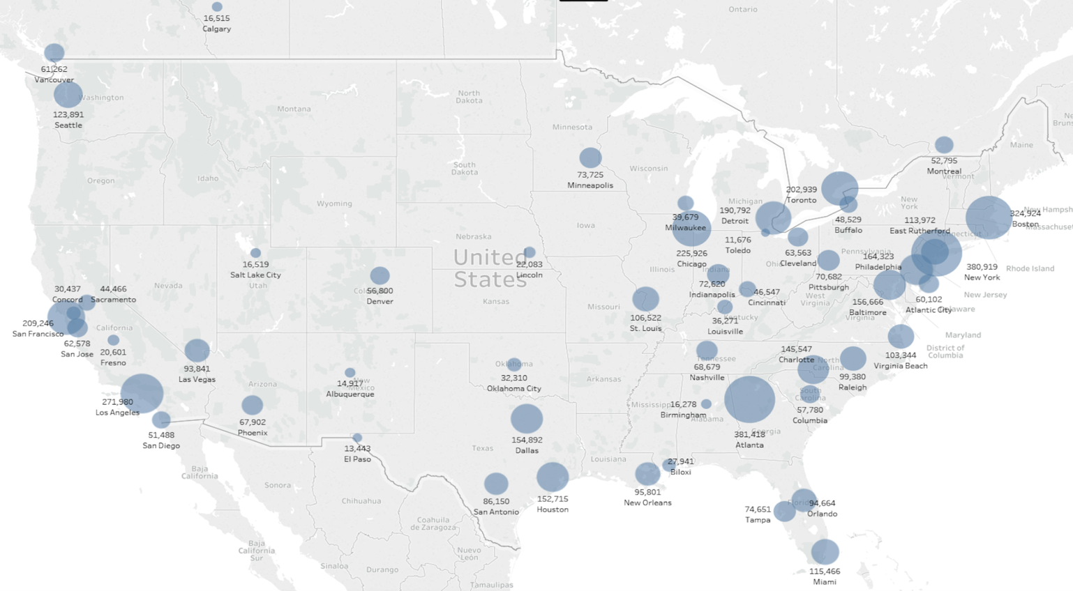
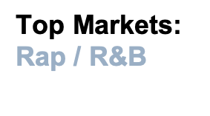


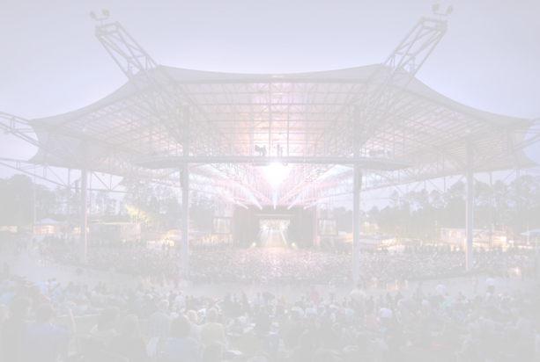

Atlanta | 381418
New York | 380919
Boston | 324924
Los Angeles | 271980
Chicago | 225926
San Francisco | 209246
Toronto | 202939
Detroit | 190792
Philadelphia | 153335
Charlotte | 145547
Seattle | 123891
Miami | 115466
East Rutherford | 113972
St. Louis | 106522
Baltimore | 106101
Virginia Beach | 103344
Dallas | 101735
Atlanta Market
Cellairis Amphitheater
Notes:
don’t compare to country. just show hip hop
geo map/graph
you can see the size of the markets we are going to start in atlanta
look at Live Nation Amps
drive current consumer traffic

Slide 17
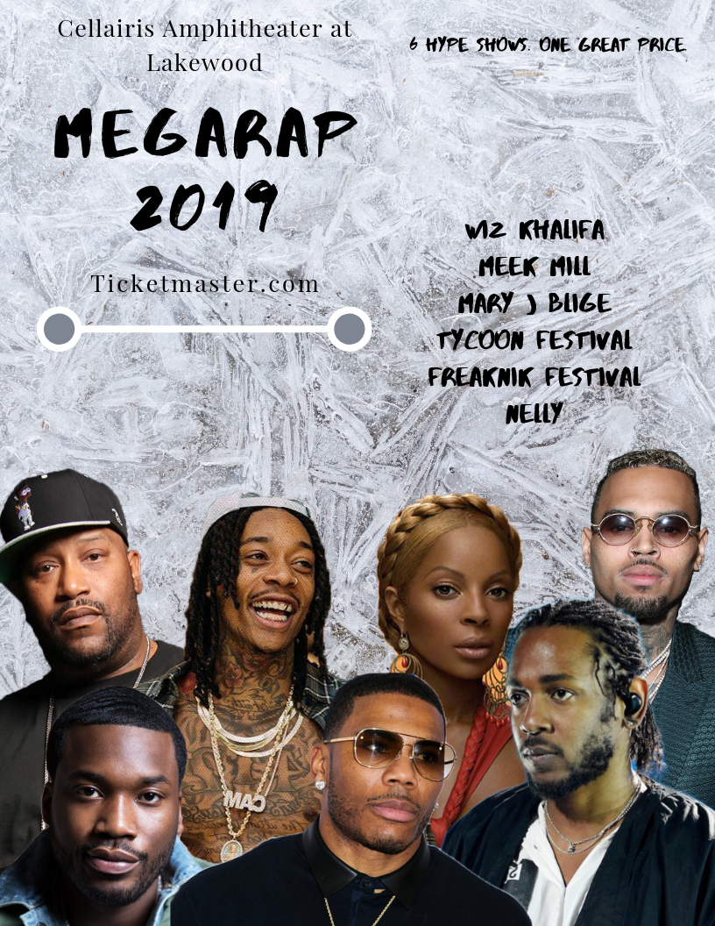
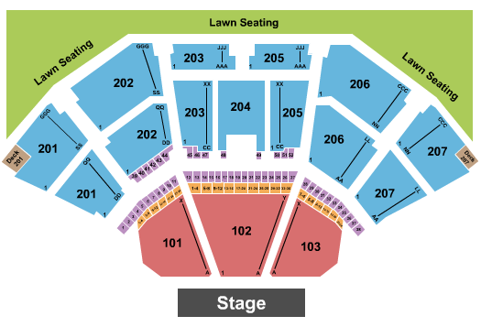
Example: Cellairis Package Options
Packages
Lawn
Lawn Seating
1 lawn seat to all 6 shows
Silver
201-203 & 205-207 Back row Level
1 reserved seat for all 6 shows
Gold
201-203 & 205-207 Front row Level
1 reserved seat for all 6 shows
Premium
100 Level
1 reserved seat for all 6 shows
MEGARAP
Notes:
Are we making a profit per customer compared to them buying each ticket separately? This is sold as a package ticket on TM.com with the contractual service charges for that price point. We would make whatever our portion of that service charge is per package sold. - Justin Atkins, Sr. Artist & Promoter Relations Manager
Mary J Blige, Freaknik Festival, Meek Mill & Future, Nelly, Tycoon Festival, Wiz
Multiple seating options that cater to a large variety of fan preferences.
Added bonuses such as fast lane entry, parking passes, and priority presale access the following year are available.
We believe having the Lawn option is not only less expensive for the younger audiences, it also gives them a chance to socialize and not be constricted to one seating area.
Upsell opps:
Parking, fast lane entry, lawn chair rentals, drink packages

Slide 18
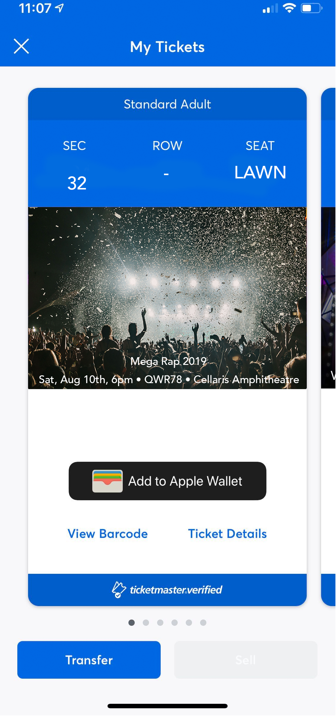
Single Barcode on Mobile
MegaRap
Simple. Easy. Fast.
No clutter.
No need to keep track of multiple paper tickets lying around.
Lessen box office traffic.
Step 1
Step 2
Step 3
Purchase your MegaRap ticket online.
Receive an email with your single barcode.
Simply save the mobile ticket to your Apple Wallet or have it ready to scan at the gate.
Notes:
Names To File: Transaction on TM, and capture all names / emails during the transaction process.
Ease of use for Fans and Clients:
Fans: Fulfill with a single barcode that’s valid for all nights in the package, right in your “wallet”
The box office no longer has to sell the individual events into accounts (like they do today for Country)
Looking at past events, Cellairis Amp has a 49% mobile ticketing use for rap and R&B artists.
Bank Of New Hampshire Pavilion in Boston has 60% - Nelly and Snoop
Columbus at Express Live! has 52% with 8 artists
They actually stopped doing megaticket as a series a few years ago – it is now a standalone event that goes up for sale and the box office sells over accounts onto the single events

Slide 19
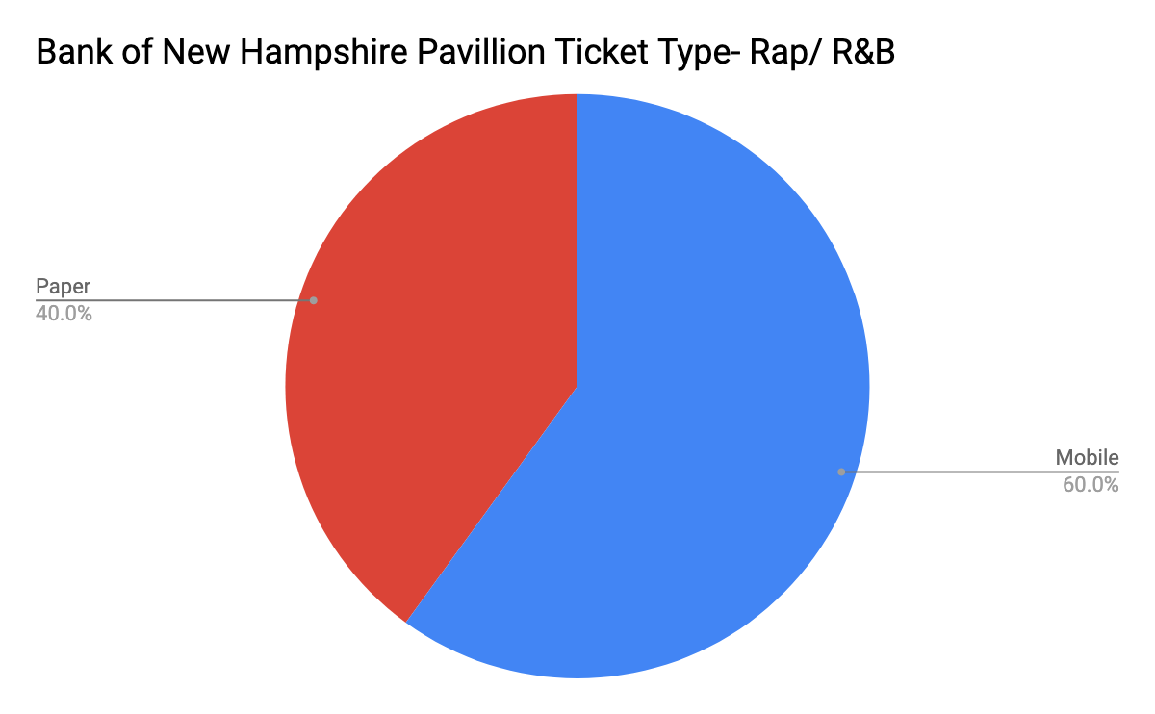
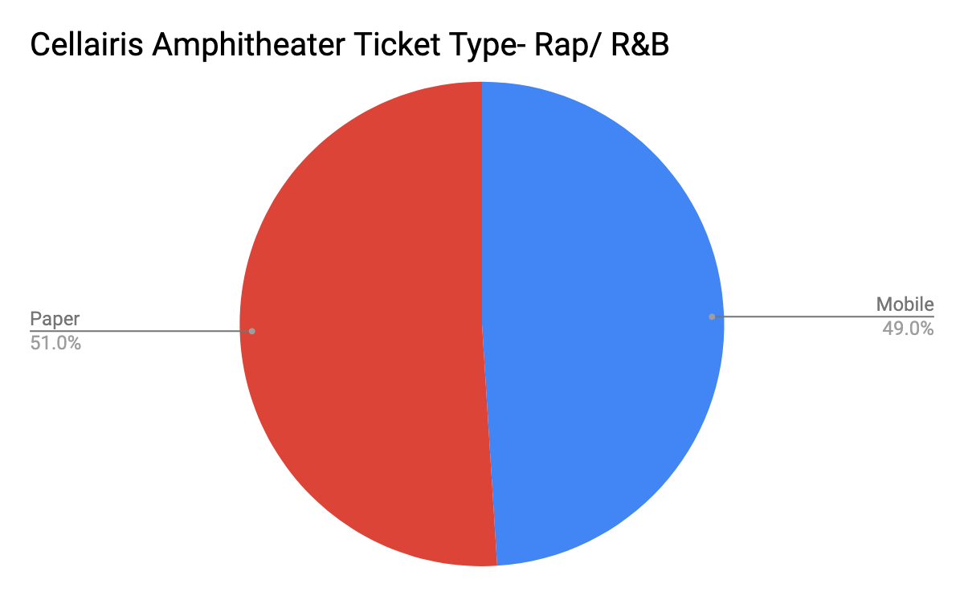
Why Mobile
with Rap?
MegaRap
We have evidence that many fans will be accustomed to using mobile ticketing services.
Notes:
Why go Mobile with Rap?
One of the big selling points with our presentation is obviously technology and youth. The future of ticketing is obviously heading towards becoming digitized, so with that we wanted to push mobile tickets in our idea. Here we have data with how it can impact mobile ticketing. At the Bank of New Hampshire we can see that 60% of the entries were through mobile ticketing and 40% were through paper. At the Cellairis in the pie chart below we can see almost an even split. Choosing the Cellairis shows us how we can slowly but surely push for mobile ticketing since half of the entries are still paper while also using the data we’ve been able to collect from New Hampshire as groundwork.

Slide 20
Ticketmaster Loyalty Program
& Credit Card

Slide 21
Why is Customer Loyalty Crucial?
33% of Americans consider switching companies after a single instance of poor service
Customers are not afraid to switch, leading to customer churn
Unable to make back the money spent on attracting them
Lose opportunity to upsell and try new products
Probability of selling to an existing customer is 60-70%
Only 5-20% for a new customer
5x
more expensive
to attract new customers
Existing
Customers
50%
67%
By year 3, loyal
customers spend
more
more willing to
try new products
Notes:
Other statistics we can mention:
Businesses loses 1.6 trillion/year when customers move away

Slide 22
Why Loyalty Program?
Retaining Customers
Ability to Tailor
Better Communication
Brand Advocates
Increase revenue by 5 to 10%, as loyalty members typically spend 5 to 20% more than ordinary users.
Loyalty programs give us greater access to customer information, allowing TIcketmaster to tailor to consumer trends.
Communication with users becomes much easier if they are part of a loyalty program.
Customers trust their friends and family - loyal customers will advocate for us.
Notes:
Retaining customers
50% consumer change their behavior to reach a higher tier
76% consumers view programs as part of their relationship with the brand
Can target at risk customers to try to bring them back into the brand
Ability to Tailor
can find out what benefits are important for their fans
can use it as a means to conduct research amongst their fans and can potentially segment it even further
Better communication
6/10 customers say surprise rewards are a reason to stay loyal. Easier to reach out on profile or something with surprise
Customer Advocacy
unhappy customers are more inclined to act & share their neg experience
81% of customers trust recommendation from friends & families rather than the company

Slide 23

Retaining
Customers
50% of consumers change their behavior to reach a higher tier in a loyalty program.
76% of consumers view programs as part of their relationship with the brand.
Increase revenue by 5 to 10%.
Loyalty members typically spend 5 to 20% more than ordinary users.

Slide 24
Key Aspects of a Loyalty Program
Emphasize the customer experience
Everything else is meant to enhance it
Build both emotional &
behavioral loyalty
Make it easy
Balance rewards mix
Easy to sign up & use
Go beyond points & discounts
Make them feel special
Be generous to customers
Exclusivity is good
Earn points/rewards through various means
Notes:
Good program emphasizes good customer experience, but it does not compensate for poor service
93% of customers are likely to repeat purchases w/ companies who offer excellent services
Make it Easy
Don’t require so much to sign up
get people from the first time w/ benefits. Don’t make it so it takes the customer over 2 years to get their first reward
But don’t make it such a passive process (will explain further on)
Make them feel special
62% of customers don’t feel the brands they’re loyal to do enough in return
if you treat everyone the same, what difference does a loyalty program make?
exclusivity is good. Treat the high spenders well by different tier levels or just by tracking their purchase
spend less time on the customers who won’t spend on your product even with all your attempt
Balance rewards mix
ie. Sephora Beauty Insider rewards Rouge members w/ free makeup class & beauty events (build a community)
85% of gen X like discounts while millennials are more inclined towards rewards
Parking redemption, special meet up for fans before or after the concert, presale opportunities
Don’t make it a passive process
if automatically giving points through purchases and easily redeem at the end of checkout, customers don’t have to think much
Make them weigh their options & decide for themselves (good research opportunity)
Market & customer preference will change and loyalty program should reflect those behavior changes
Be generous
do you want purchasing to be the only means of getting points?
Make it a bit more interactive w/o making it too much work
follow social media account, follow content, watch videos
** extremely important to constantly keep track of their experience and continue improving. Check the customer retention rate, rate of redemption (see what rewards are of value to the customers), negative churn (how many customers are staying), NPS, & customer effort score (who is sharing by word of mouth)

Slide 25
Ticketmaster Loyalty Program Proposal
Make it Easy
Make Them Feel Special
Automatically enroll with a Ticketmaster account
First purchase bonus
Every dollar corresponds to one point
Reward differently based on:
Amount spent
# of tickets purchased
# of events attended
Balance Rewards Mix
Be Generous to Customers
Presale opportunities
VIP packages
Ticket upgrades
Parking deals
Meetup for fans
Buying 10+ tickets/year doubles points on those tickets
Sharing on social media collects points
Get points for transferring & accepting tickets
Notes:
Make it easy
automatically enroll with a ticketmaster account
First purchase bonus
Every dollar spent gets one points
Make them feel special
Reward people w/ x amount of ticket purchases with special event invites
Reward based on
amount spent
but also # of events attended/tickets bought
Balance Rewards Mix
Presale opportunities,
VIP packages
Ticket upgrades
Special discounts on future tickets
Fan meetings
Be Generous
If buy 20+ tickets/year, those points are doubled
If you buy a ticket, have option of sharing on social media to collect points
Watching ™ ads
Getting points on transferring & accepting tickets
good incentive for people to actually transfer their ticket

Slide 26
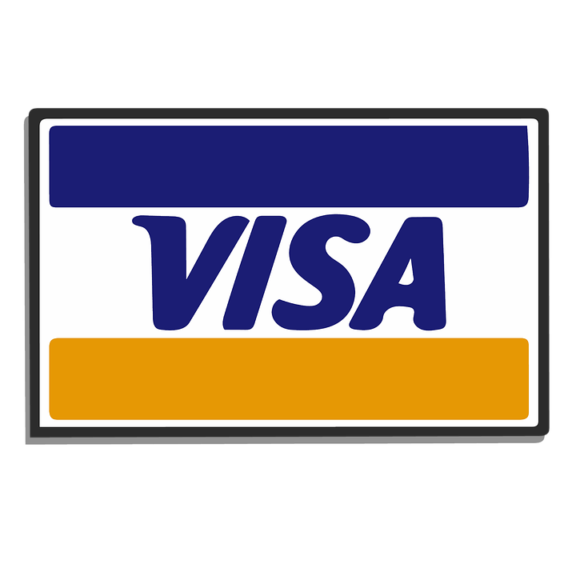
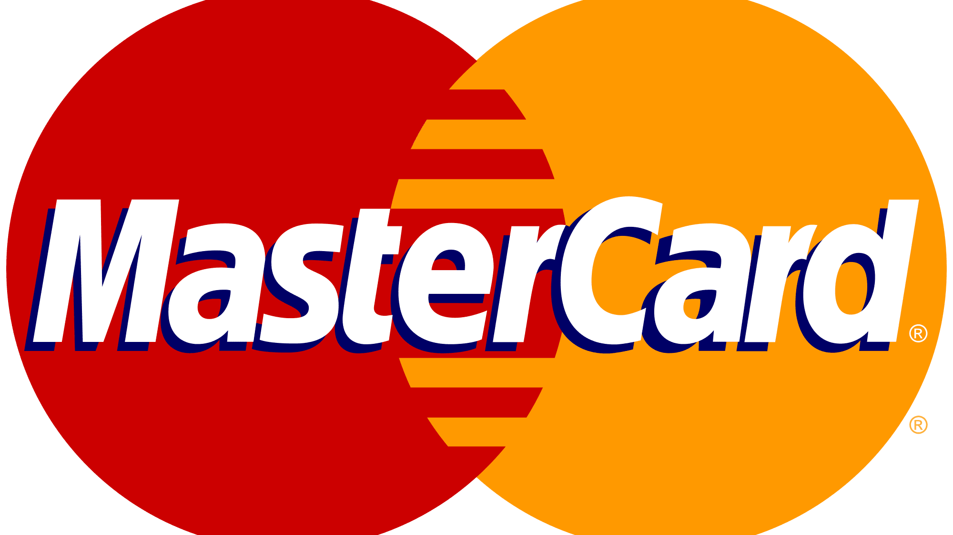


What is a Co-Branded Credit Card?
Mutual partnership that provides merchant-specific benefits to brand-loyal customers
Issuer - Bank behind the card, ultimately in charge of approvals, interest rates, debt.
Carries the brand of a partner - making card more appealing to target customers
NOT Private Label Credit Card (Store Card) -- Can be used outside of Ticketmaster
Why would an issuer partner with a merchant?
Costco + AMEX
Notes:
Costco Example -- 20% of Loans and Revenue and 10% of all AMEX Cards

Slide 27
In 4 years, Millennials will make up:
Millennials and Credit Cards
Will become the customer segment with the greatest personal income ---> $8.3 USD trillion by 2025.
Four reasons why we shouldn’t miss this opportunity:
Use cards more than other segments.
More likely to apply for credit.
Spending will increase as they age.
Open to new and emerging payment products.
75% of Workforce
46% of U.S. Total Income

Slide 28
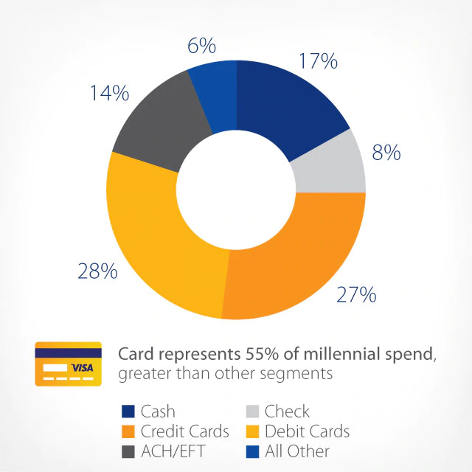
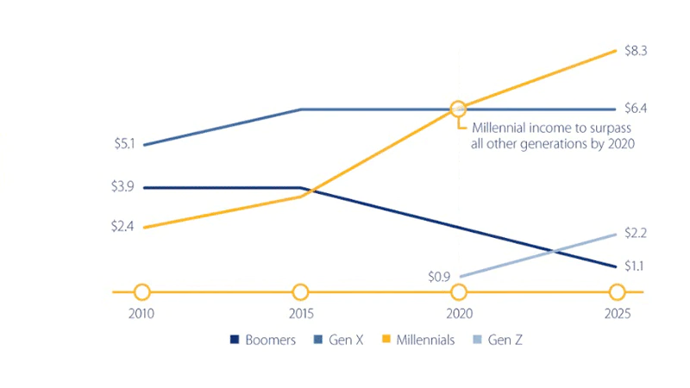
The Opportunity: Why Target Millennials
Notes:
Visa’s data indicates that millennials use cards for 57 percent of their spending , and with increasing wages and reduced debt, they’re an attractive target for debit and credit card marketing.
They’re willing to migrate cash and other transactions to card products, when designed for their needs. Millennials are also more likely to revolve and pay fees.

Slide 29
Why Credit Card?
Revenue Sharing on Credit Card Fees
Increased Customer Engagement &
Strengthening Loyalty Programs
Access to Better Customer Data
Improved Marketing & Branding
Interest/Late Fees & Transaction Fees
IDENTITY
Aggregated Data of Demographics and Shopping Behavior
More Accurate Target Marketing
67% of consumers shop more frequently and spend more at retailers with loyalty programs.
Notes:
Revenue Sharing on Credit Card Fees
If the customer ends up paying interest or late fees to the issuer, the co-branding partner gets a revenue sharing kickback from the issuer. If the customer uses the co-branded card at other places, the co-branding partner also gets a percentage of the fees earned by the issuer. American Express said 70% of the purchases on Costco AmEx cards are made outside Costco. Costco likely gets a portion of American Express’s fees on those 70% in addition to a portion of the interest and late fees paid by the customers to American Express (not all customers pay in full every month).
Increased Customer Engagement
A 2016 report by The Nielsen Company found that "67% of consumers shop more frequently and spend more at retailers with loyalty programs."Not only can customers earn points for shopping with the issuing brand but anywhere else they take their card.
This arrangement has the power to benefit both the company and its customers. The brand involved is encouraging their users to be return customers. In turn, so long as they have a point balance, cardholders will be incentivized to come back; it's a form of positive reinforcement.
Because the co-branded cards often give special discounts or earn double points for spending at the co-branding partner ...customers with a co-branded card tend to spend more.
Access to Better Customer Data
The co-branding partner also gets aggregated data from the issuer on the customers’ demographics and their shopping behavior. The data help the partner market its products.
IDENTITY
Spending Habits/ Pattern
Improved Marketing & Branding

Slide 30
Wrap Up
Main Ideas:
TicketmasterU
MegaRap Ticket
Loyalty Program/ Credit Card

Slide 31
Questions?
Credit to the Ticketmaster Employees who helped us move forward with this presentation:
Monica Ek - Front Gate Tickets
David Marcus - EVP, Head of Music
Leslie Alvarado - Artist/Promoter relations coordinator
Justin Atkins - Country Megaticket
Pete Lamson - VP of Operations
Michael Abbatiello - US Concerts, Director of Ticket Operations
Angela Chun - Intern, Payments
Genesis Artiga - Client Support Specialist
Prateek Anand - Senior Data Scientist
Mahesh Goud - Applied Scientist
Sarah Slater - VP Music and Festivals, UK

Slide 32
Thank You

